Slide 1

Happy Insurance Analysis Project PP/PQ/Power BI/DAX
Shira Saroossi
Dror Givon
Hani Exterman
Jan 22nd, 2021

Slide 2
Project Phases
Analysis – Power BI, Tabular Editor, DAX
ETL Process - PP/PQ
Tabular Model
Upload data from SQL and from excel to PQ
Understand the data and business insights in would like to get from it
Edit tables to create DIM tables - add SK (Segregate Key), BK (Business Key), relevant data
Create DIM date table
Use OrderLines table to create Fact sales table with all SK and business data
Create Star Cheme in PP - connecting Fact table SK to the DIM tables BK
Upload Model to Power BI
Clean tables – hide unneeded fields
Rename tables names - make it clear to understand
Create dynamic measures
Create dynamic KPIs using Tabular Editor
Create measurements
KPIs in PP

Slide 3
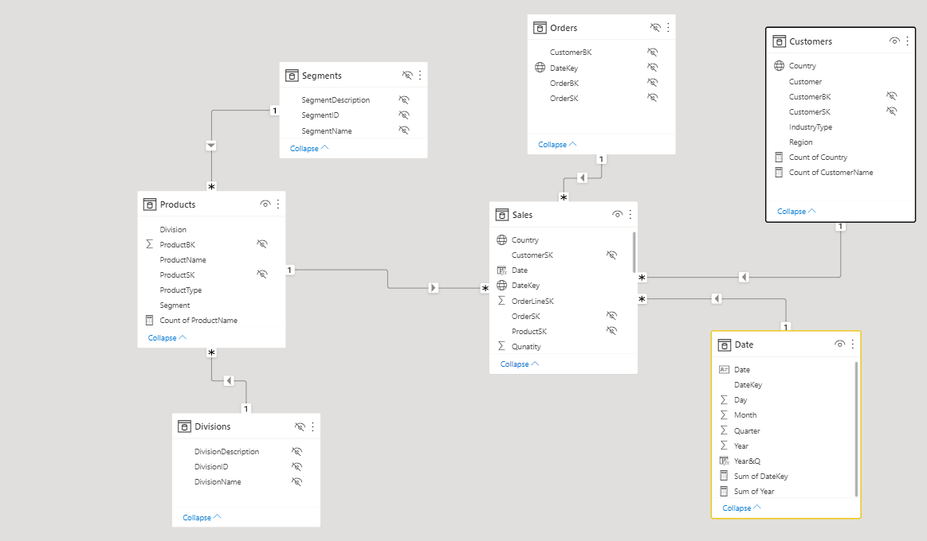
Star Scheme

Slide 4
Assumptions
Assurance company working with agents:
End user
Distribution
CEO Dashboard in Power BI to visualize 3 years of business
Analysis in this presentation is based on Power BI (not all is shown in the dashboard) as well as Power Query excel
Losses per order line are due to claims insurance only (does not include company expenses)

Slide 5
Issues & Mitigations
Problem | Where? | How we resolved?
DIM date created initial wasn’t sufficient. we created it again and had to upload only the fixed table into the model | PQ, Power BI | copy paste PQ code into the power BI
ETL process - division segment wasn’t connected to fact table | PQ | merged division and segment table into product table using product key
Orders and Orderline tables seemed confusing | PQ | understood the data - Orders included few order lines by Quarter

Slide 6
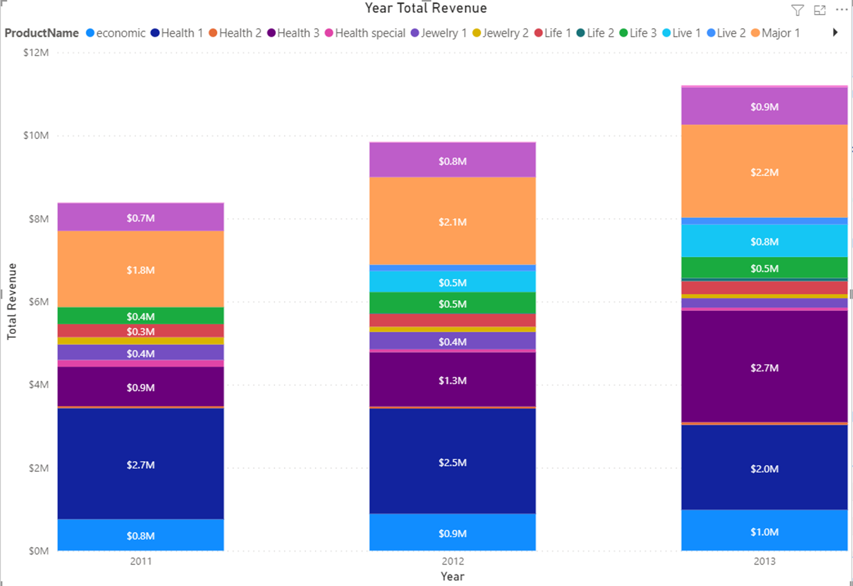
Overall Revenue Trend
YOY Growth 17.4% in 2012 and 13.8% in 2013
Higher revenue growth in 2012 vs. 2013 mainly due to Health 1 product which declined in 2013

Slide 7
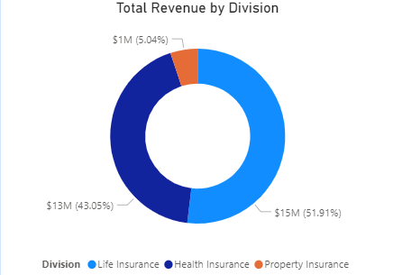
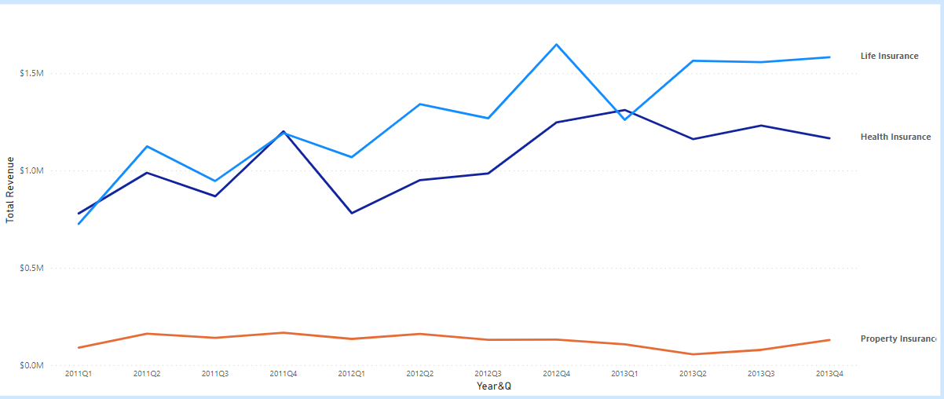
Divisions Revenue Trend Life Insurance is the company growth driver (Over 50% out of total)
Life insurance is the largest division in revenue and highest growth past
Property insurance is lowest and stagnated during the past 3 years

Slide 8
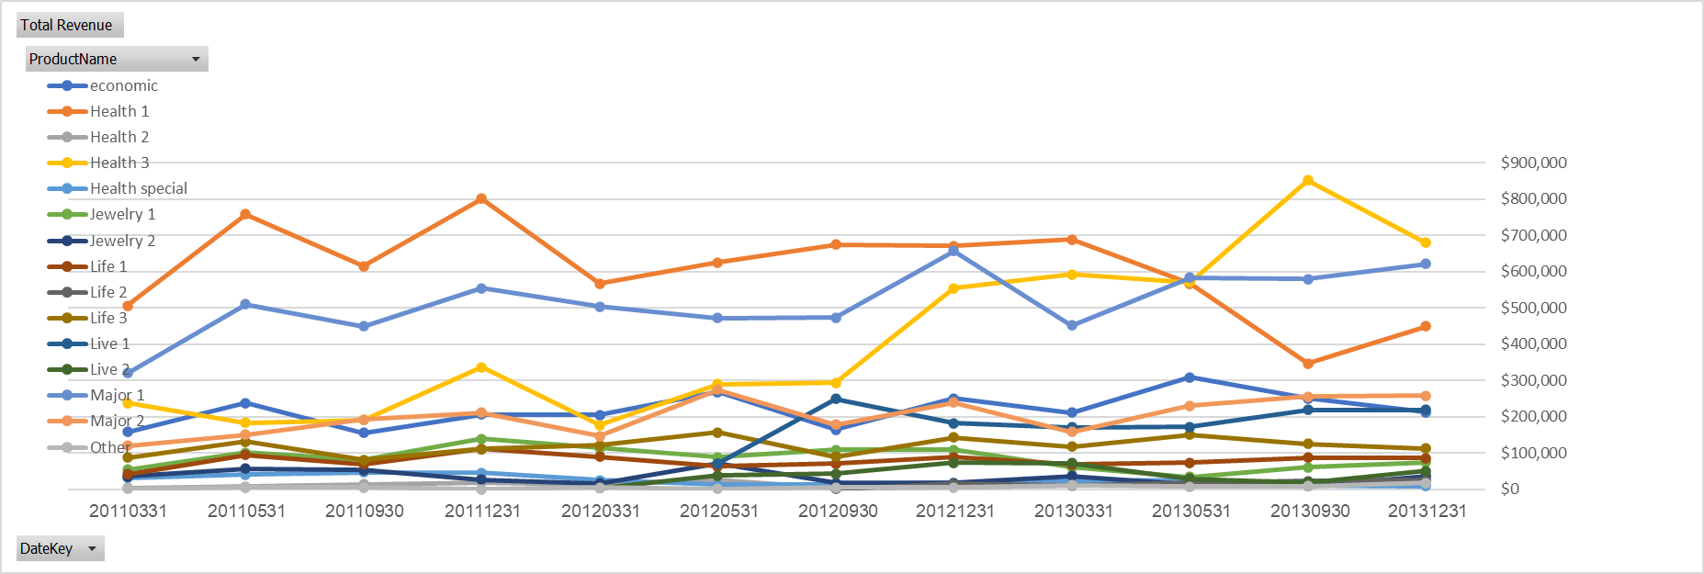
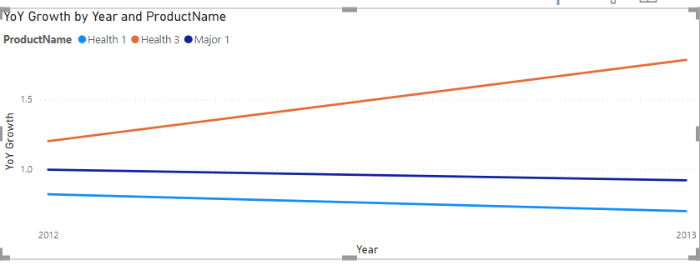
Top 3 Products Trend in Health and life insurance Health3 product is the highest growing: 178% YOY!!
Health1, Health3 and Major1 - are the top 3 products of “Happy Insurance”
Health3 : Change of trend from 2012 to 2013 and become the largest in revenue vs. Health1 which was the highest in 2011-2012
Health 3 is the highest in revenue mainly due to high unit price
Major1 and Health1 growth past seems to start declining (revenue is still growing)

Slide 9
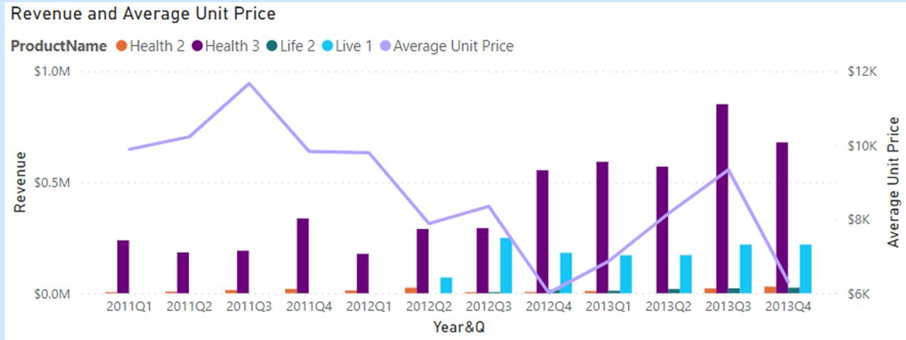
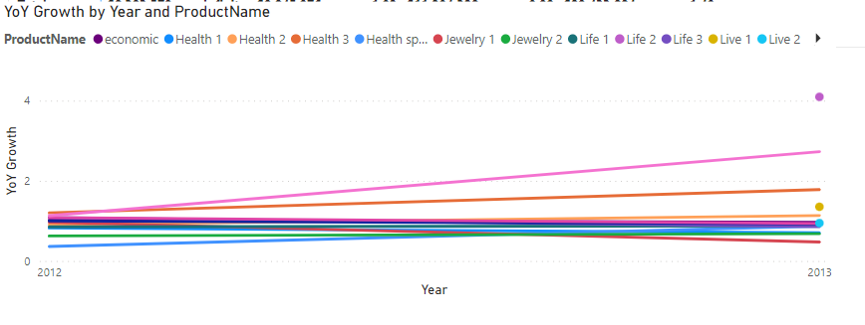
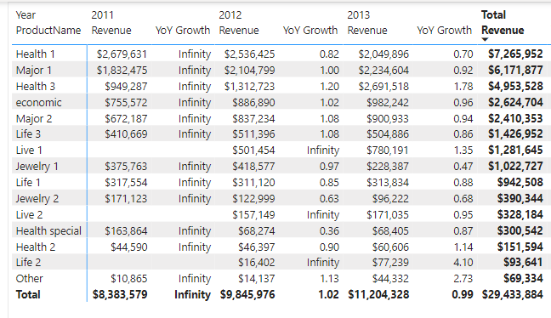
Product growth trend – All Highest growing product is live 2 which grew more than 4 times from 2012 to 2013 however is still very low in overall revenue
Health3, Live 1, Health2 and Life2 are the only products growing YOY
Live2 - new product added in 2012 and grew dramatically in only 1 year. Good potential product
Health3 is in the top 3 products and in shows growth YOY

Slide 10
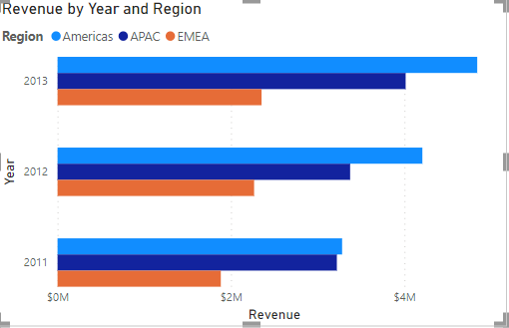
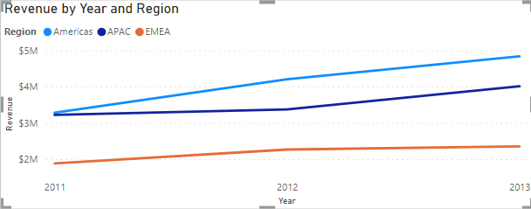
Regional Revenue Trend Americas is the largest Region ,however APAC is the fastest Growing (103%)
Americas is the highest in revenue and growing, however growth ratio seems to lower from year to year (111% from 2011 to 2012 and 101% from 2012 to 2013
EMEA is the lowest region in addition declining from 2012 to 2013
APAC is growing in the highest past

Slide 11
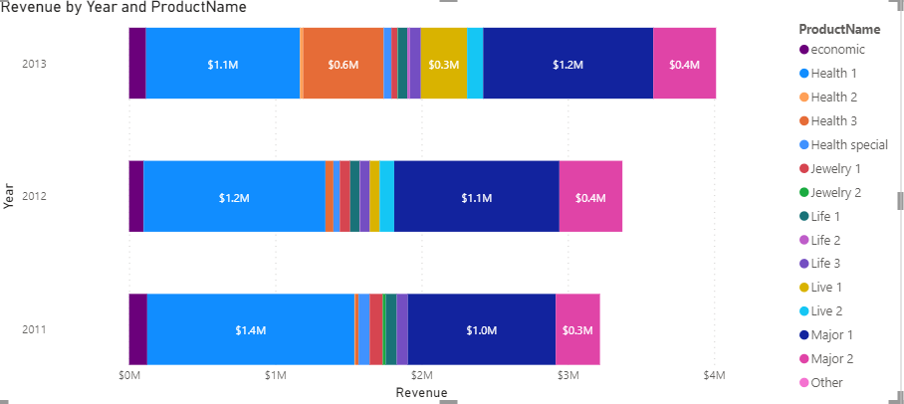
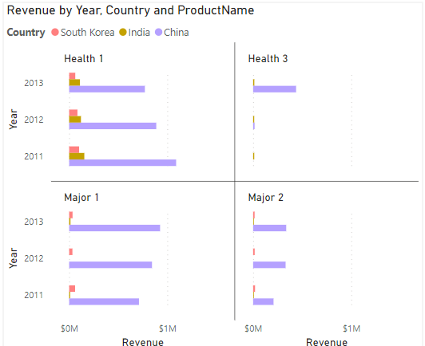
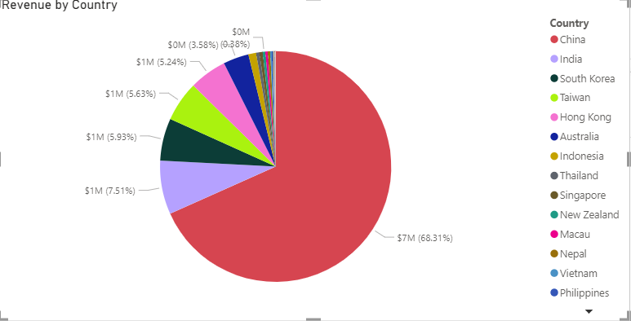
APAC Top 3 products in APAC: Major1, Health1 and Health3
Majority of APAC revenue is from China

Slide 12
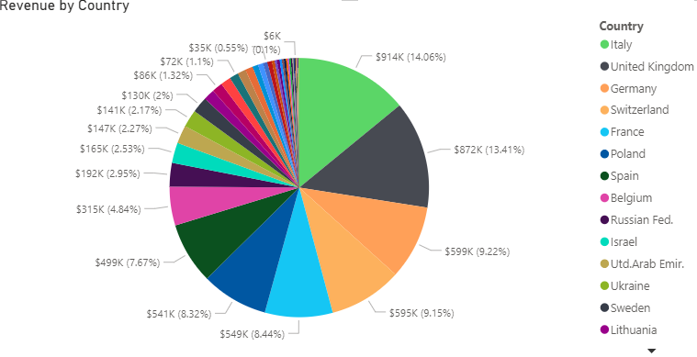
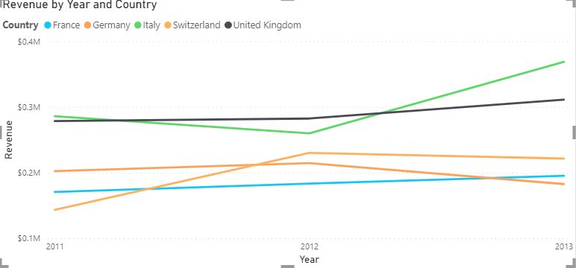
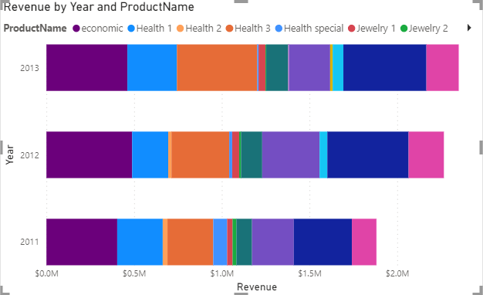
EMEA Top 3 products in EMEA: Economic, Major1, Health1, Health3
Fragmented Region: Half of the revenue is from Italy, UK, Germany, Swiss and France
Italy is the largest country in EMEA and growing in the largest paste
UK and France are also growing
Germany and Swiss are declining from 2012 to 2013

Slide 13
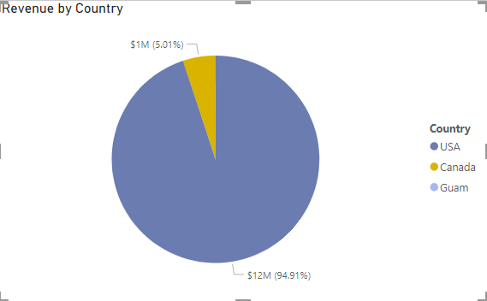
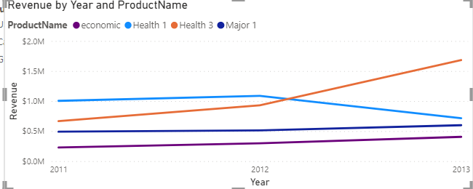
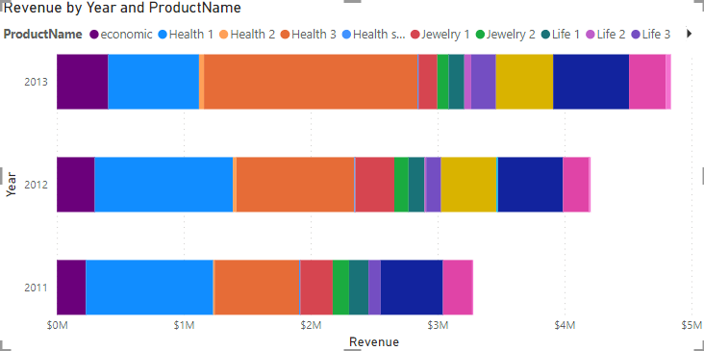
Americas Top 3 products in Americas: Economic, Health1, Health3
95% of the revenue is from the US
Out of the top products in Americas:
Health3 is highest in revenue and growing (160%)
Health1 is 2nd highest however is declining fastly
Economic and Major 1 is in steady growth past (~105%)

Slide 14
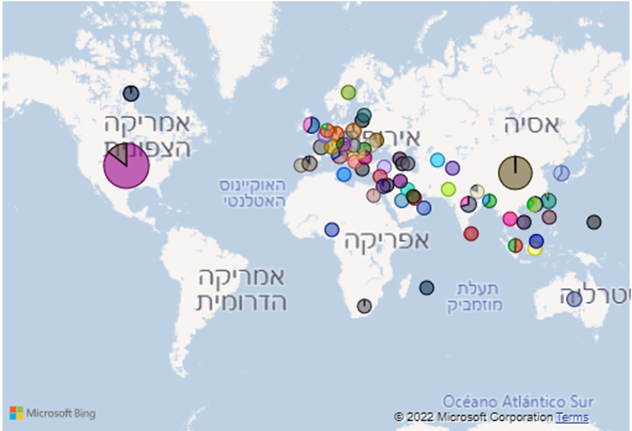
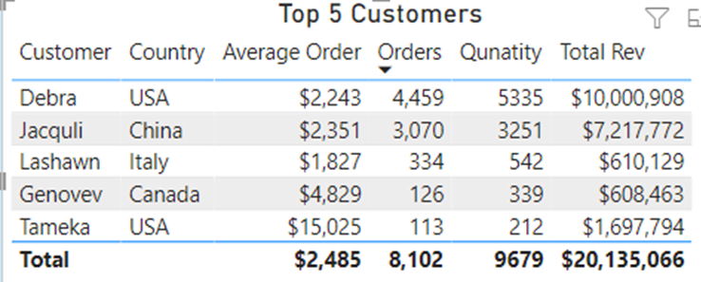
Customers
There are 2 major customers that brings more than 50% of the total revenue:
Debra and Jacquli

Slide 15
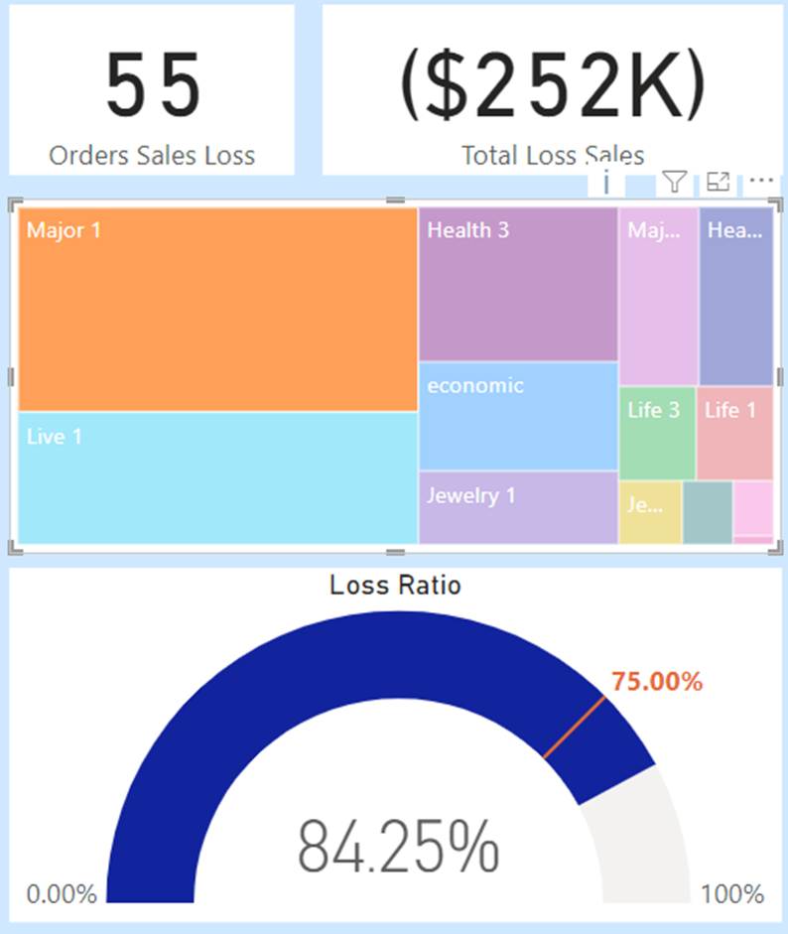
Losses sales
Analysed loses by product and calculated loses ratio assuming 75% is the minimum ratio from revenue
High loss ratio: None
Medium ration (80%): Major1, live1, life2
Low in loses - rest of the products

Slide 16
Business Questions
Revenue trend per period
Revenue trend per year
Is there a strong month or quarter per year?
Is there s strong period per the different products/segments/product type/Division?
Product type/division/segment
What is the largest (In revenue, in number of orders) segment/product/product type /Division per year?
What is the trend per product type – growing, declining, stagnation
Which is the fastest growing segment/product/product type?
Customers and industry type
Which is the largest industry?
Revenue trend – same as #3
“Lost” customers – customers that stopped buying and when
Top 10 customers – revenue and number of orders
What happened to the top 10 over the years? Changes trends

